Slide 1
Mortgage Statistics of the US
N.A.A.M
Nipun, Atharva, Anishka, Mudit

Slide 2
Problem Statement
To conduct a comprehensive analysis of the NMDB® Aggregate Mortgage Statistics, to understand the relation between mortgage metrics and the diverse factors that influence it.
By combining univariate and multivariate studies with rigorous statistical tests and advanced machine learning techniques, we aim to offer actionable insights that can guide strategic planning and decision-making in the housing market, benefiting both industry stakeholders and potential clients.

Slide 3
Plan Of Action
Data Cleaning & Processing
Machine Learning Exploration
Data Analysis & Visualization
Hypothesis Testing & Experimentation

Slide 4
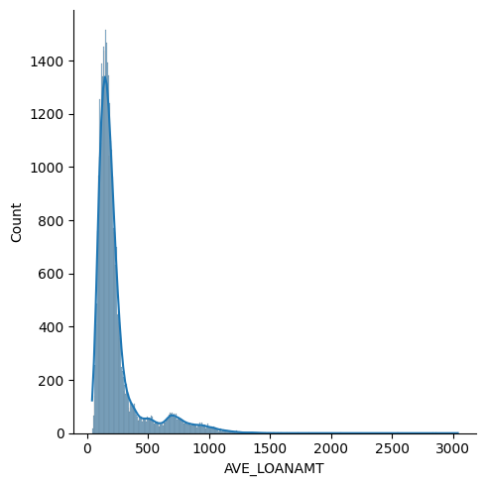
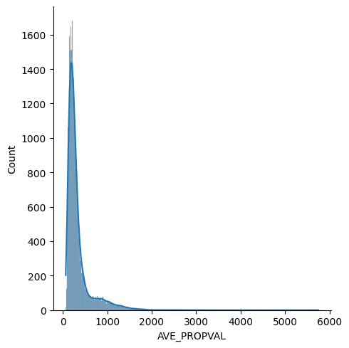
Hypothesis - 1
T-correlation test between Loan Amount & Average Property Value
H(0) ⇒ There is no correlation between the two variables
H(1) ⇒ There is correlation between the two variables
Hypothesis Test Result :
Correlation Value: 0.9795359301202943, Alpha: 0.0
T = 287.84094637927336, DOF = 3498
0.0 < 0.05: NULL hypothesis REJECTED in testing phase
Hypothesis Test Validation on the Dataset :
Correlation Value: 0.9770737986403297, Alpha: 0.0
T = 888.0454526278678, DOF = 37443
0.0 < 0.05: NULL hypothesis REJECTED in validation phase
Notes:
This is Total Loans given vs Interest Rate?

Slide 5
Hypothesis - 2
T-correlation test between No of Origins & Average Interest Rate
H(0) ⇒ There is no correlation between the two variables
H(1) ⇒ There is correlation between the two variables
Hypothesis Test Result :
Correlation Value: 0.017871487831611743, Alpha: 0.29051239936620227
T = 1.0571581884984413, DOF = 3498
0.29051239936620227 >= 0.05: NULL hypothesis ACCEPTED in testing phase
Hypothesis Test Validation on the Dataset :
Correlation Value: 0.027364049475720357, Alpha: 1.183973808640816e-07
T = 5.296980141841564, DOF = 37443
1.183973808640816e-07 < 0.05: NULL hypothesis REJECTED in validation phase

Slide 6
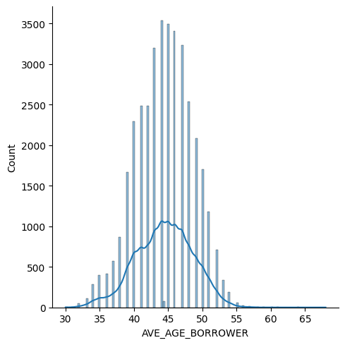
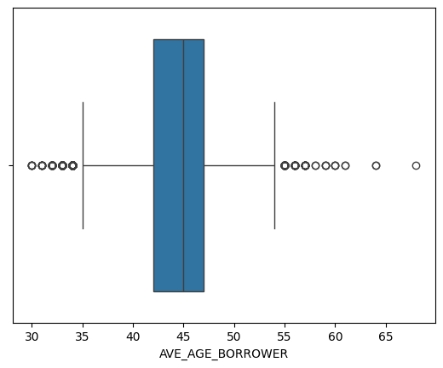
Hypothesis - 3
T test for testing AVG_AGE.
There is no significant difference between the sample mean and a hypothesized population mean.
H(0) ⇒ Over the years, average age of borrowers is 43
H(1) ⇒ Over the years, average age of borrowers is not 43
Hypothesis Test Result :
T Value: 19.4232473984624, Alpha: 6.850787325812924e-80
6.850787325812924e-80 < 0.05: NULL hypothesis REJECTED in testing phase
Hypothesis Test Validation on the Dataset :
T Value: 67.87150582237888, Alpha: 0.0
0.0 < 0.05: NULL hypothesis REJECTED in validation phase
Comparing sample distribution with the population mean
Sample_Mean = 44.355946483998714 POP_MEAN = 44.45317349887617
T Value: -1.392727800148613, Alpha: 0.1637906047621321
0.1637906047621321 >= 0.05: NULL hypothesis ACCEPTED in sample vs pop phase

Slide 7
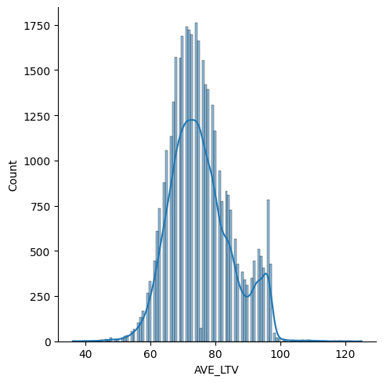
Hypothesis - 4a
T test for testing AVG_LTV.
There is no significant difference between the sample mean and a hypothesized population mean.
H(0) ⇒ Over the years, average Loan To Value is 75.
H(1) ⇒ Over the years, average Loan To Value is not 75
Hypothesis Test Result :
T Value: 1.6855948615908338, Alpha: 0.09196302323982113
0.09196302323982113 >= 0.05: NULL hypothesis ACCEPTED in testing phase
Hypothesis Test Validation on the Dataset :
T Value: 7.629662690193031, Alpha: 2.4093454201861012e-14
2.4093454201861012e-14 < 0.05: NULL hypothesis REJECTED in validation phase
75.26950208712405 75.37621748902923
Comparing sample distribution with the population mean
T Value: -0.6674491282183207, Alpha: 0.5045293098464224
0.5045293098464224 >= 0.05: NULL hypothesis ACCEPTED in sample vs pop phase

Slide 8
Hypothesis - 4b
T test for testing AVG_LTV.
There is no significant difference between the sample mean and a hypothesized population mean.
H(0) ⇒ Over the years, average LTV is 75
H(1) ⇒ Over the years, average LTV is not 75
Hypothesis Test Result :
T Value: -88.34745297805568, Alpha: 0.0
0.0 < 0.05: NULL hypothesis REJECTED in testing phase
Hypothesis Test Validation on the Dataset :
T Value: -296.569221439842, Alpha: 0.0
0.0 < 0.05: NULL hypothesis REJECTED in validation phase
Comparing sample distribution with the population mean
75.7923592299812 75.37621748902923
T Value: 2.5876965420284823, Alpha: 0.009701948549316173
0.009701948549316173 < 0.05: NULL hypothesis REJECTED in sample vs pop phase

Slide 9
Post Midsem Presentation
In contrast to prior reports that primarily focused on demographic and geographic aspects of mortgages, our study uniquely intertwines these elements with external economic indicators like GDP, unemployment rates, and economic crises, offering a deeper understanding of mortgage behaviors.
Our multivariate approach, combined with rigorous hypothesis testing, ensures a comprehensive and validated view of the mortgage landscape.
Additionally, our intent to employ ML modeling techniques, unexplored in previous studies, further enhances our analysis, promising novel insights and addressing gaps in earlier research.

Slide 10
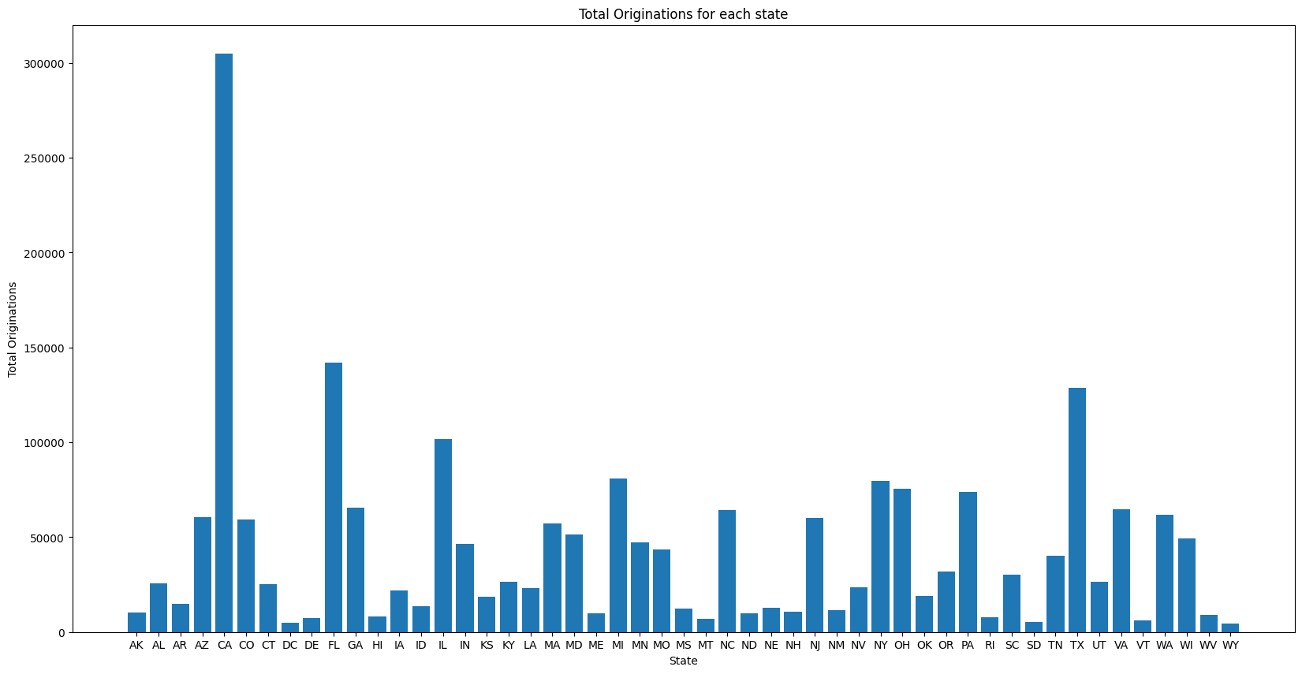
Hypothesis - 5(a)
ANOVA
TOT_ORIGINATIONS
H0 = Means of all groups are same
H1 = Mean of at least one group is different.
ANOVA Test Result:
F-statistic: 342.48728611459245
p-value: 0.0
Alpha = 0.05
Number of not rejects: 400
Number of rejects: 875
Since alpha > p, we reject the null hypothesis and can conclude that the distributions of at least one of the state is different. Pairwise test of each state using TukeyHSD shows we reject 875 out of 1275 pairwise state
We performed analysis of variance to compare the distribution of the 50 states in USA to check if they are constant throughout the country. This is done for 3 variables: TOT_ORIGINATIONS, AVE_LOANAMT and AVEINTRATE.
Notes:
This is Total Loans given vs Interest Rate?

Slide 11
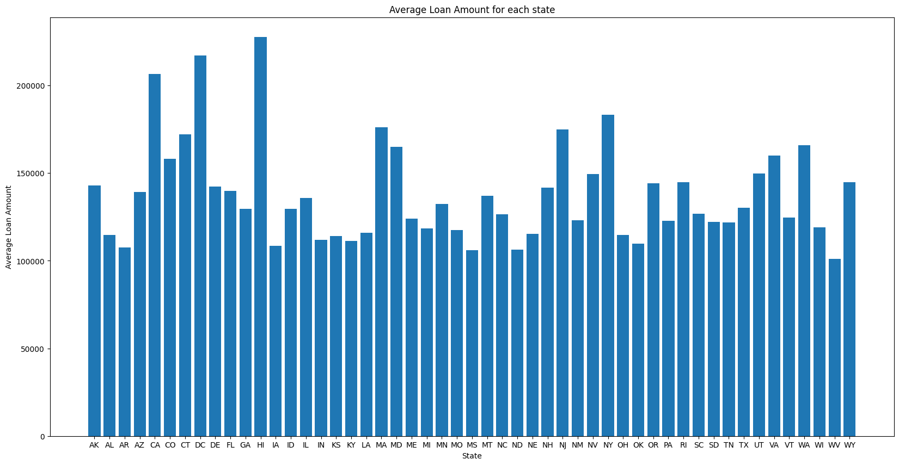
Hypothesis - 5(b)
AVE_LOANAMT
H0 = Means of all groups are same
H1 = Mean of at least one group is different.
ANOVA Test Result:
F-statistic: 35.70318260463009
p-value: 0.0
Alpha = 0.05
Number of not rejects: 724
Number of rejects: 551
Since alpha > p, we reject the null hypothesis and can conclude that the distributions of at least one of the state is different. Pairwise test of each state using TukeyHSD shows we accept 724 out of 1275 pairwise state which is higher than total originations. This can be seen from the graph as well where the states have similarity in average loan amounts over the years. This can also be seen from the smaller F-statistic as compared to the one obtained in total originations.
Notes:
This is Total Loans given vs Interest Rate?

Slide 12
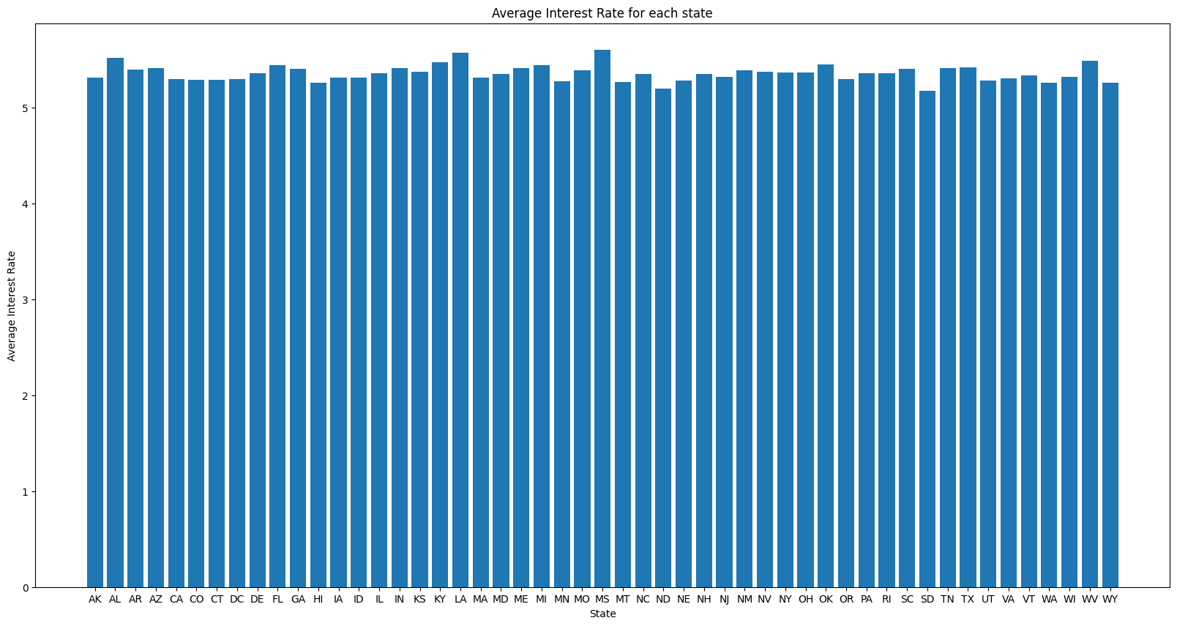
Hypothesis - 5(c)
AVE_INTRATE
H0 = Means of all groups are same
H1 = Mean of at least one group is different.
ANOVA Test Result:
F-statistic: 1.873370854377587
p-value: 0.00018365483723495088
Alpha = 0.05
Number of not rejects: 1271
Number of rejects: 4
Since alpha > p, we reject the null hypothesis and can conclude that the distributions of at least one of the state is different. Pairwise test of each state using TukeyHSD shows we reject just 4 pairwise combinations of states. This can be seen from the graph as well where the states have an almost equal average interest rate over the years. This can also be seen from the much smaller F-statistic and a p-value greater than 0. This shows for most states, the interest has shown similar pattern over the years.
Notes:
This is Total Loans given vs Interest Rate?

Slide 13
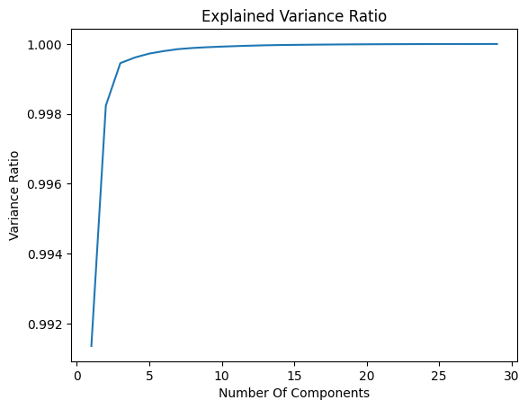
Data Processing & PCA
We cleared the data to remove features having no correlation with the target variable and use features relevant to the value being predicted.
Conducted MinMax Scaling to scale the data into a range of 0 to 1.
Conducted PCA to get an idea of the explained variance ratio to understand the number of features relevant for analysis and to understand the correlation between different variables.
AVE_LOANAMT skewness: 2.776116846197745
AVE_LOANAMT kurtosis: 10.295564840229021
Removing outliers by removing all values beyond the IQR(Interquartile Range).

Slide 14
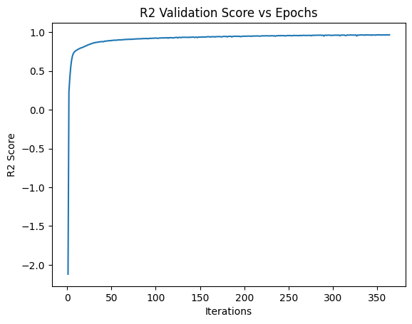
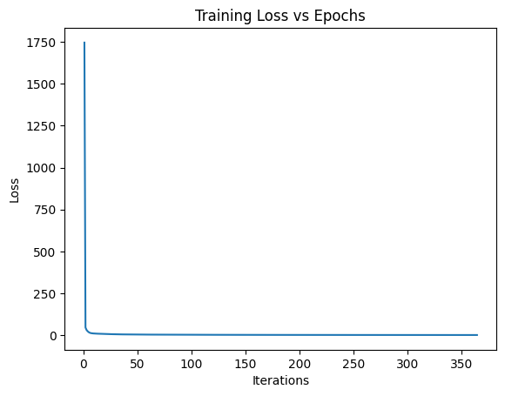
ML Hypothesis 1 (Regression)
Predicting Average LTV using State Level Data & predicting National Level Average LTV using the model.
Training Data : State Level Estimates
Testing Data : National Level Estimates
Score Metric : R2 Score
Model | Without One Hot Encoding
Linear Regression | -44.67
Decision Tree Regressor | 0.62
Multi Layer Perceptron | 0.396

Slide 15
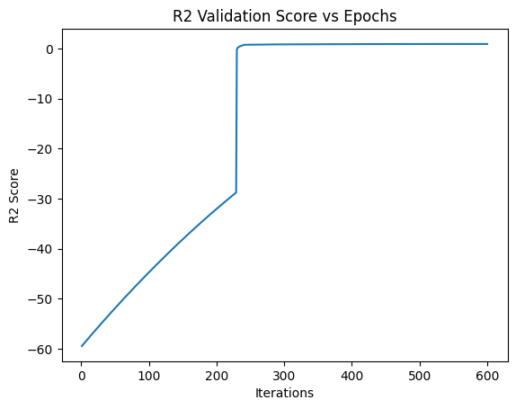
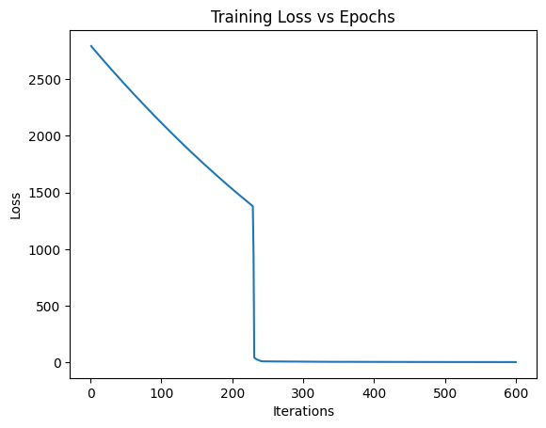
ML Hypothesis 2 (Regression)
Predicting Average LTV by combining state-wise data & national level data.
Score Metric : R2 Score
Model | Without One Hot Encoding | With One Hot Encoding
Linear Regression | 0.895 | 0.924
Decision Tree Regressor | 0.892 | 0.889
Multi Layer Perceptron | 0.944 | 0.966

Slide 16
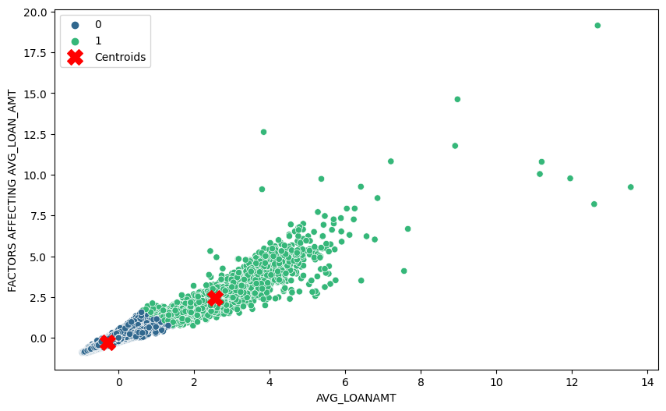
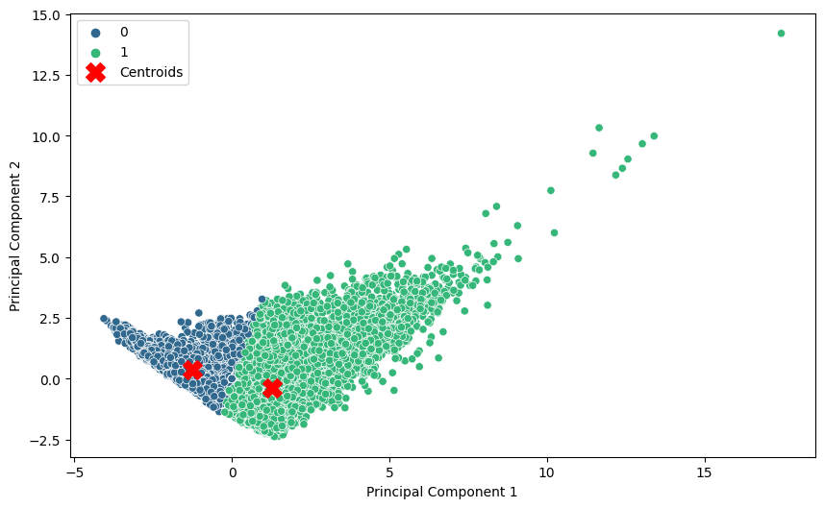
Clustering
Analyse the relation between the avg loan amount and factors affecting the average loan amount
Used to pca to bring the computation down to 2 dimensions
We combine the factors affecting loan amount and apply PCA to these factors and compare them against loan amount in clustering analysis.

Slide 17
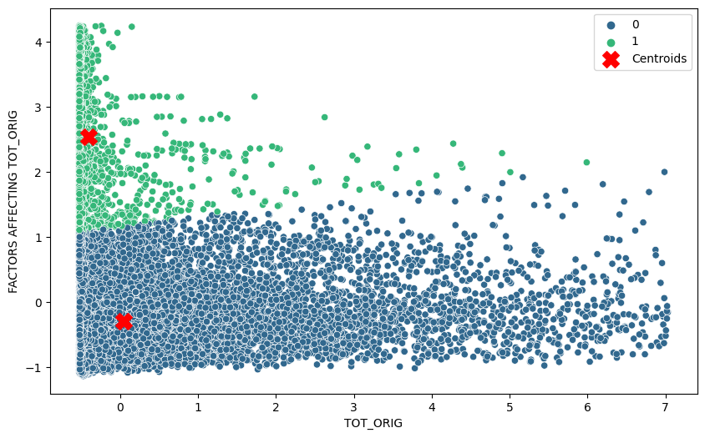
Clustering
Analyse the relation between the Total Loans Originated and factors affecting the total load originations
Used to pca to bring the computation down to 2 dimensions

Slide 18
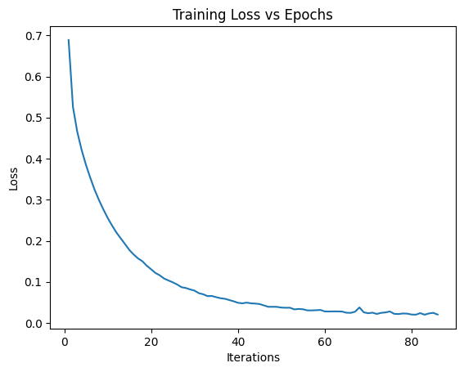
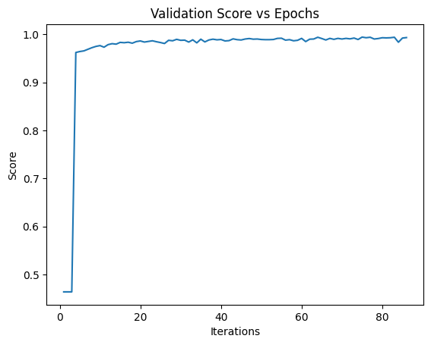
ML Hypothesis - 3 (Classification)
Predictive analysis of the % loans allocated to enterprises. If the % loans assigned to enterprises is more than 50% of all the loans assigned then we can say that there would be a startup boom in the market during that period.
Model | Accuracy
Logistic Regression | 97.92%
Naive Bayes | 85.34%
K - Nearest Neighbors | 89.75%
SVM | 97.58%
Multi-Layer Perceptron | 99.13%

Slide 19
Inferences
Prediction for Hypothesis 1 & 2 :
A higher LTV ratio often suggests that borrowers are taking on more debt relative to the value of the property, which can be indicative of an overheated housing market or more relaxed lending standards. Conversely, a lower LTV ratio might indicate a more conservative lending environment and potentially a more stable housing market.
Prediction for Hypothesis 3 :
The distribution of loans between enterprises (including startups) and government entities can be a barometer of economic confidence and market dynamics. A higher percentage of loans to enterprises and startups suggests a robust entrepreneurial ecosystem and possibly a favorable investment climate for these entities.

Slide 20
THANK YOU

